Slide 1

TRIBHUVAN UNIVERSITY
Faculty of humanities and social science
Ratna Rajya Laxmi Campus
Exhibition Road, Kathmandu
Music Streaming Platform
Submitted by
Bisham Raj Pandey-15 Bishal Regmi-14
Submitted to
Department of Computer Application
Ratna Rajyalaxmi Campus

Slide 2
Introduction
The platform allows users to listen to music and interact with it by liking or disliking tracks.
Users can create personalized playlists from the songs they’ve liked.
Artists can upload their music and specify preview segments to showcase specific parts of their tracks.
The system includes a recommendation algorithm that tailors song suggestions based on user preferences and interactions.

Slide 3
Problem Statement
Short Attention Spans and Song Previewing Needs.
Lack of Personalized Recommendations
Limited User Interaction with Music
Difficulty in Managing Playlists

Slide 4
Objectives
Develop a user-friendly music streaming platform
Implement a customizable preview system
Build a recommendation algorithm

Slide 5
Requirement Analysis
Problems of current systems
Music recommendations are often generic and fail to adapt to user preferences.
Users struggle to find new music that matches their tastes.
Playlist creation can be tedious, with too many options and no personalized filtering.
Advantages of Proposed system
The recommendation system adapts in real-time based on user interactions.
Users can easily curate playlists from songs they have already liked.
The preview system helps users quickly decide if they enjoy a song.

Slide 6
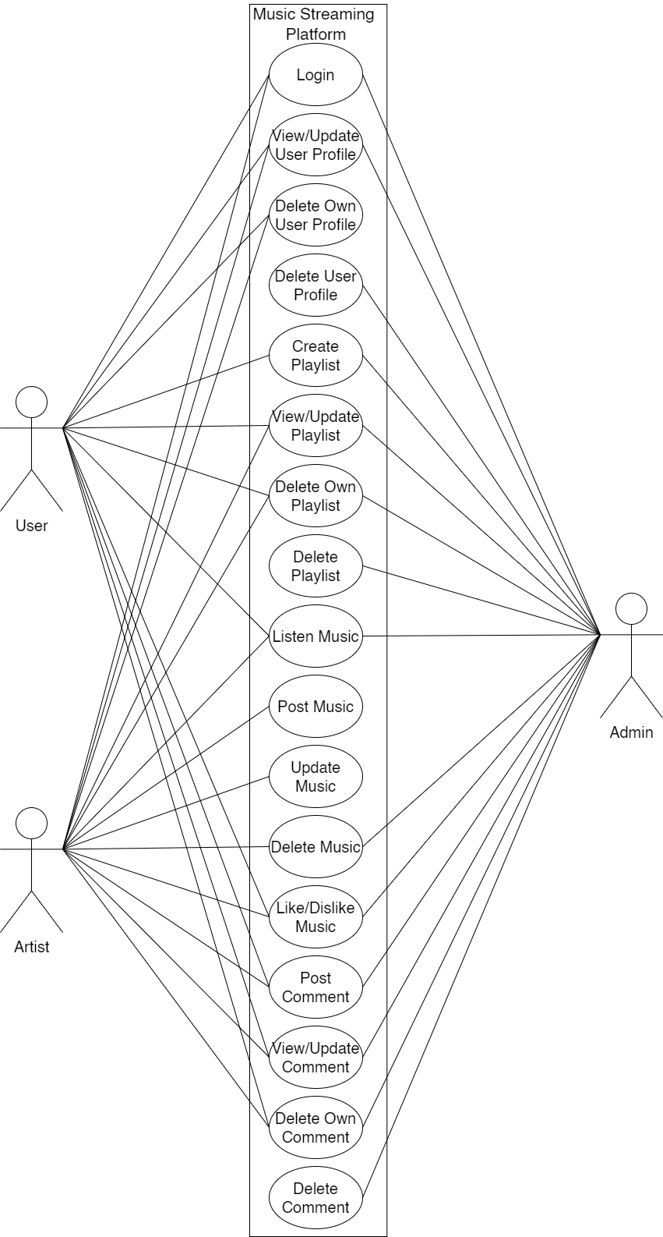
Use-Case Diagram

Slide 7
Description of Algorithm
Collaborative filtering is a recommendation technique that predicts a user’s preferences based on the behavior of similar users. Instead of analyzing song attributes, it focuses on user interactions, making recommendations more personalized and dynamic.
Working of Collaborative Filtering:
Data Collection – Gathers user interactions (likes, skips, listening duration) to build a preference database.
User-Item Matrix Creation – Constructs a matrix mapping user to songs based on their interactions.
Similarity Calculation – Identifies users with similar listening behaviors using similarity metrics like cosine similarity.
Recommendation Generation – Suggests songs a user hasn’t heard based on what similar users enjoy.
Continuous Improvement – Updates recommendations in real-time as users interact with new songs.

Slide 8
Feasibility study
Technical
The proposed music streaming platform is technically feasible, utilizing the MERN stack (MongoDB, Express.js, React.js, Node.js) for a seamless full-stack environment. MongoDB efficiently manages music data, while Node.js enables real-time recommendation updates and playback. The system is scalable. Performance challenges, such as smooth music transitions and optimized database queries, will be addressed through efficient backend logic. Overall, the chosen technologies ensure reliability, scalability, and a smooth user experience.
Language used: MongoDB, Express.js, React.js, Node.js

Slide 9
Feasibility study
Operational
The existing operational model ensures efficient throughput and quick response times.
The organization will reap significant benefits from the proposed system.
The available resources are utilized effectively to deliver a high-quality system within the set timeline.
Economic
The system offers cost-effectiveness.
The streamlined resource management will lower the overall system cost.
The advantages provided by the system will significantly outweigh its costs

Slide 10
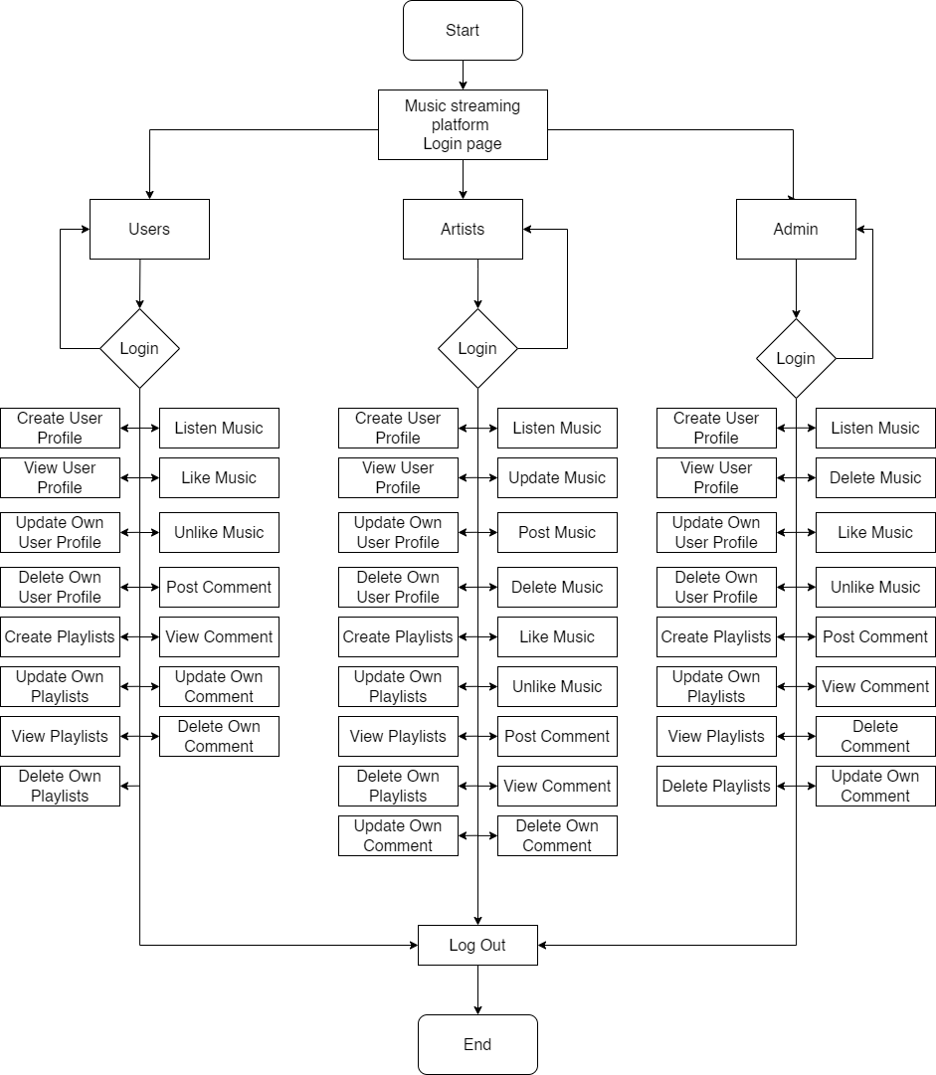
High Level Design of System

Slide 11
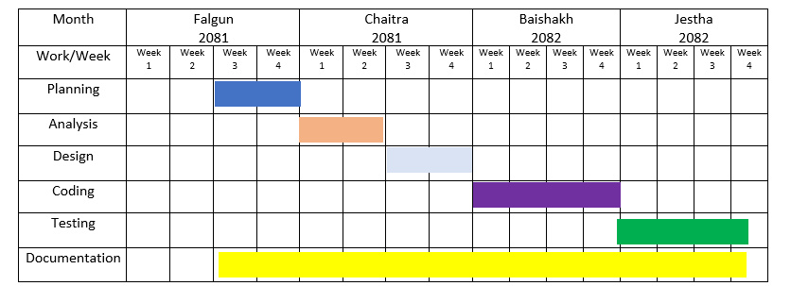
Gantt Chart

Slide 12
Expected Outcome
Improved User Experience: Users will be able to effortlessly interact with the platform, swiping through songs, and enjoying the content with minimal effort.
Responsive Interface: The platform will adapt seamlessly to various devices, ensuring smooth performance across all screen sizes.
Effective Communication: Users and artists can engage with each other through features like direct messaging and comments, fostering better interaction.

Slide 13
References
[1] J. Daher, 18 11 2023. [Online]. Available: https://www.thedartmouth.com/article/2023/09/trends-shorter-songs. [Accessed 25 2 2025].
[2] S. Bludov, "www.dataart.com," 12 2019. [Online]. Available: https://www.dataart.com/media/3234/shortening-attenting-spans-sb.pdf. [Accessed 23 2 2025].
[3] S. Stella, "publicknowledge.org," 9 3 2023. [Online]. Available: https://publicknowledge.org/new-public-knowledge-paper-shines-a-light-on-the-broken-music-streaming-industry. [Accessed 9 3 2023].
[4] J. Shotwell, "https://artists.bandsintown.com/," [Online]. Available: https://artists.bandsintown.com/support/blog/short-attention-spans-are-dramatically-altering-songwriting-heres-how. [Accessed 25 2 2025].
[5] "www.sharetopros.com/," 16 8 2023. [Online]. Available: https://www.sharetopros.com/blog/the-challenges-and-obstacles-facing-the-music-industry-today.php. [Accessed 25 2 2025].

Slide 14
Thank
You

